Slide 1
The views expressed in this document are those of the ADB staff and do not necessarily reflect the views and policies of the Asian Development Bank or its Board of Governors or the governments they represent.

Slide 2
Asian Development Outlook 2018 How Technology Affects Jobs
Juzhong Zhuang
Deputy Chief Economist
Asian Development Bank
April 2018

Slide 3
Key messages
Developing Asia to continue solid growth at 6.0% in 2018 and 5.9% in 2019 amidst the strong external and domestic demand
PRC moderating with greater focus on financial stability; India rebounding from temporary reform related setbacks
Firming commodity prices and consumer demand push inflation to 2.9% in 2018 and 2019—still below 10-year average
Key risks stem from escalating trade tensions, rising US interest rates, and accumulating domestic private debt
New technologies are not likely to cause widespread job losses in Asia. But policy action is needed for workers to overcome challenges posed by technological advance and harness its full benefits

Slide 4
Developing Asia continues its solid growth…
forecast
NIEs = newly industrialized economies of Hong Kong, China; Republic of Korea; Singapore; and Taipei,China
Source: Asian Development Outlook database.

Slide 5
…supported by robust growth in advanced economies
GDP growth (%) | 2016 Actual | 2017 Actual | 2018 ADO 2018 projection | 2019 ADO 2018 projection
Major industrial economies ª | 1.5 | 2.3 | 2.3 | 2.0
United States | 1.5 | 2.3 | 2.7 | 2.3
Euro area | 1.8 | 2.5 | 2.2 | 1.9
Japan | 0.9 | 1.7 | 1.4 | 1.0
ª Average growth rates are weighed by gross national income, Atlas method.
Sources: US Department of Commerce, Bureau of Economic Analysis, http://www.bea.gov; Eurostat, http://epp.eurostat.ec.europa.eu; Economic and Social Research Institute of Japan, http://www.esri.cao.go.jp; Consensus Forecasts; Bloomberg; CEIC Data Company; Haver Analytics; World Bank, Global Commodity Markets, http://www.worldbank.org; ADB estimates.

Slide 6
Synchronized trade resurgence in 2017…
Growth in nominal exports
Growth in nominal imports
Note: For BRU, CAM, and MYA, 2017 refers to data as of November; and for KGZ, as of April.
Sources: CEIC Data Company and Haver Analytics (accessed 3 March 2018).

Slide 7
...to continue at a more modest pace
Exports growth, selected economies
Semiconductor shipments
Source: CEIC Data Company (accessed 2 March 2018)
IC = integrated circuits
Notes: Forecasts are as of 28 November 2017. Numbers are rounded up.
Source: World Semiconductor Trade Statistics (http:/www.wsts.org).
Notes: ASEAN-5 is composed of Indonesia, Malaysia, the Philippines, Thailand and Viet Nam; NIEs – are newly-industrialized economies composed of Hong Kong, China; Republic of Korea; Singapore; and Taipei,China

Slide 8
Domestic demand still the main growth driver…
Demand-side contributions to growth, selected economies, 2017
NIEs
ASEAN-5
Notes: ASEAN = Association of Southeast Asian Nations; NIEs = newly industrialized economies; GDP = gross domestic product; HKG = Hong Kong, China; IND = India; INO = Indonesia; KOR = Republic of Korea; MAL = Malaysia; PHI = the Philippines; PRC = People’s Republic of China; SIN = Singapore; TAP = Taipei,China; THA = Thailand. IND data refers to H1 FY2017. Components do not add up to total due to a statistical discrepancy.
Sources: Haver Analytics and CEIC Data Company (accessed 2 March 2018);
Asian Development Outlook database.

Slide 9
...and strong consumption set to continue
Consumer confidence index, % change
Notes: Data for Hong Kong, China; Malaysia and Philippines are on a quarterly basis. For the Philippines, the index refers to consumer expectations, computed as the percentage of households that answered in the affirmative less the percentage of households that answered in the negative. A positive (negative) CEI indicates a favorable (unfavorable) view.
Source: Haver Analytics; CEIC Data Company (accessed 20 March 2018).

Slide 10
2018 and 2019 should consolidate gains
 | 2017 | 2018 | 2019 |  | 2017 | 2018 | 2019
 | Actual | Forecast |  |  | Actual | Forecast
East Asia | 6.3 | 6.0 | 5.8 | South Asia | 6.4 | 7.0 | 7.2
China, People’s Rep. of | 6.9 | 6.6 | 6.4 | Bangladesh | 7.3 | 7.0 | 7.2
Hong Kong, China | 3.8 | 3.2 | 3.0 | India | 6.6 | 7.3 | 7.6
Korea, Rep. of | 3.1 | 3.0 | 2.9 | Pakistan | 5.3 | 5.6 | 5.1
Taipei,China | 2.9 | 2.9 | 2.8
 |  |  |  | Central Asia | 4.3 | 4.0 | 4.2
Southeast Asia | 5.2 | 5.2 | 5.2 | Azerbaijan | 0.1 | 1.7 | 2.0
Indonesia | 5.1 | 5.3 | 5.3 | Kazakhstan | 4.0 | 3.2 | 3.5
Malaysia | 5.9 | 5.3 | 5.0
Philippines | 6.7 | 6.8 | 6.9 | The Pacific | 2.2 | 2.2 | 3.0
Singapore | 3.6 | 3.1 | 2.9 | Fiji | 3.9 | 3.6 | 3.3
Thailand | 3.9 | 4.0 | 4.1 | Papua New Guinea | 2.2 | 1.8 | 2.7
Viet Nam | 6.8 | 7.1 | 6.8
Developing Asia | 6.1 | 6.0 | 5.9 | Excluding NIEs | 6.6 | 6.5 | 6.4

Slide 11
PRC growth will sustain moderation in favor of reforms
Demand-side contributions to growth
Growth will moderate over 2018–2019
Government priorities to improve quality of growth:
1 Heading off financial risks
2 Controlling environmental pollution
3 Targeted intervention to eliminate poverty
forecast
Sources: Bloomberg; Haver Analytics; and CEIC Data Company (accessed 19 February 2018).

Slide 12
India growth picks up as headwinds fade
Temporary effects from demonetization and GST rollout easing
Growth to accelerate in FY2018 and FY2019
India forecast to be the fastest growing large economy
GST=goods and services tax, PMI=purchasing managers index

Slide 13
The pickup in global commodity prices...
Sources: Bloomberg; World Bank. Commodity Price Data (Pink Sheet). http://www.worldbank.org (accessed 16 March 2018).

Slide 14
...will give a modest boost to inflation
forecast
Source: Asian Development Outlook database.

Slide 15
Risks to the outlook are on the downside
Escalation of trade tensions
Limited impact of US tariffs so far
Further US tariffs or responses to them could tip the balance
Interest-rate induced capital flow shifts
Baseline assumes rising path of US Fed interest rates
A more aggressive stance could reverse Asia’s capital flows
Impact of rising private debt on growth
Quality of debt should be pushed, need to closely monitor debt trends and build more efficient financial systems
Improved fiscal and financial positions bolster developing Asia’s resilience to shocks

Slide 16
Theme chapter: How Technology Affects Jobs

Slide 17
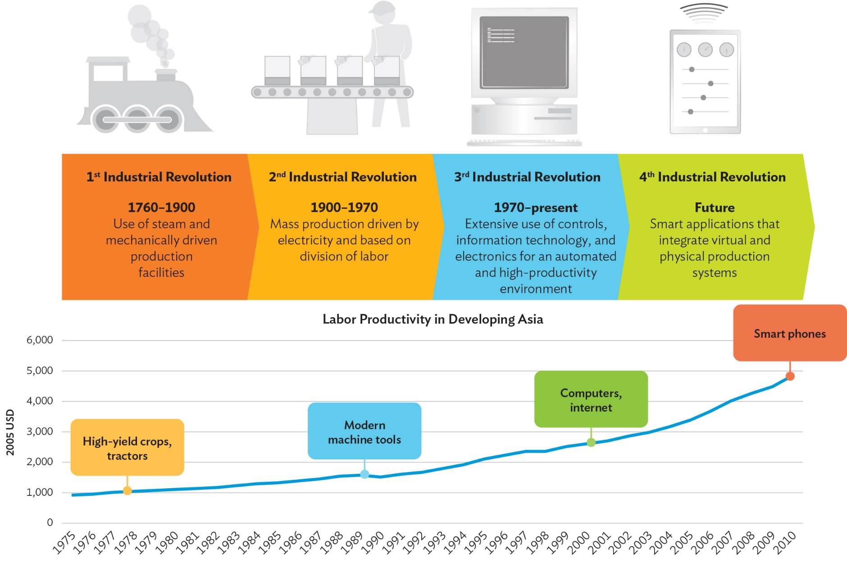
Technological advancement drives higher productivity, the foundation for better-paid jobs and economic growth

Slide 18
There are compelling reasons for optimism about developing Asia’s job prospects
New technologies often automate only some tasks of a job.
Technical feasibility does not guarantee economic feasibility.
Rising income and demand.
New occupations and industries.

Slide 19
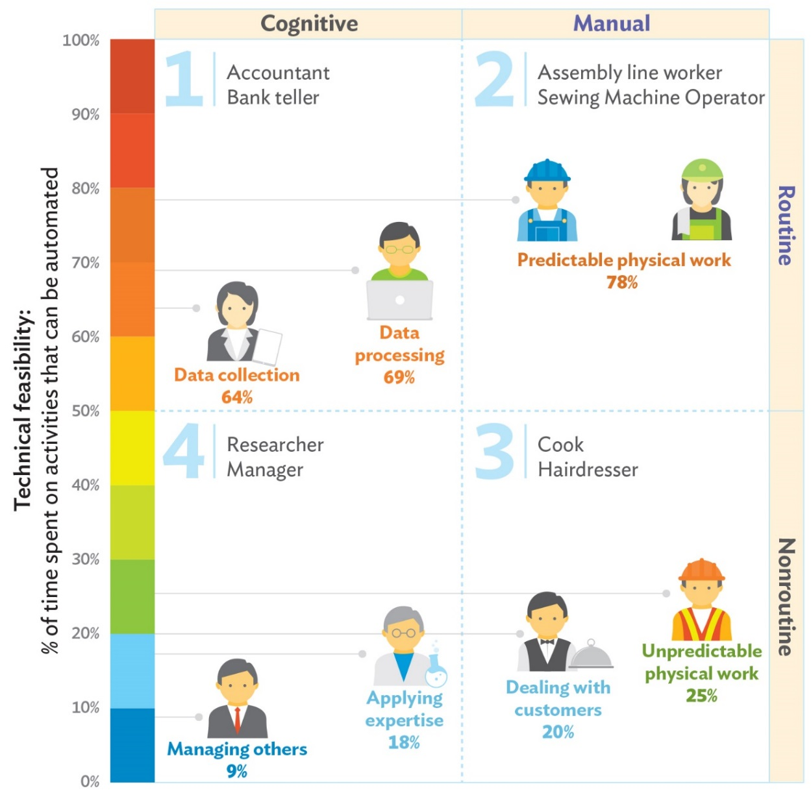
New technologies often involve automating specific tasks associated with a job, not the job in its entirety
Note: Percentages refer to Frey and Osborne (2017) estimates on probability of automation. Framework is based on Acemoglu and Autor (2011).
Source: Asian Development Outlook 2018: How Technology Affects Jobs.

Slide 20
Industrial robots are concentrated in capital intensive sectors where employment shares are relatively small
Source: Asian Development Outlook 2018: How Technology Affects Jobs.

Slide 21
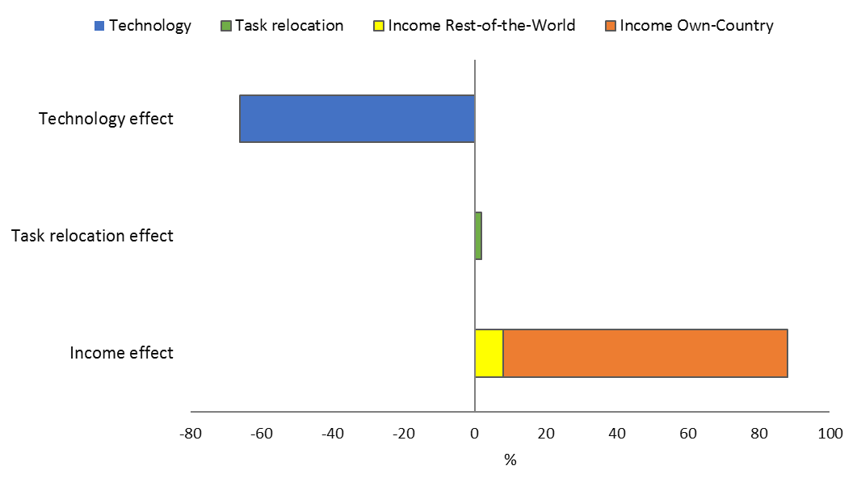
Rising demand offsets displacement driven by automation
Decomposing the percentage change in employment, 2005-2015
Note: Developing Asia in the decomposition analysis includes Bangladesh, India, Indonesia, Malaysia, Mongolia, the People’s Republic of China, the Philippines, the Republic of Korea, Sri Lanka, Taipei,China, Thailand, and Viet Nam.
Sources: Decomposition result using ADB Multiregional Input–Output Database (accessed 20 November 2017); Labor force surveys, various countries; World Input–Output Database—Socioeconomic Accounts (Timmer et al. 2015).

Slide 22
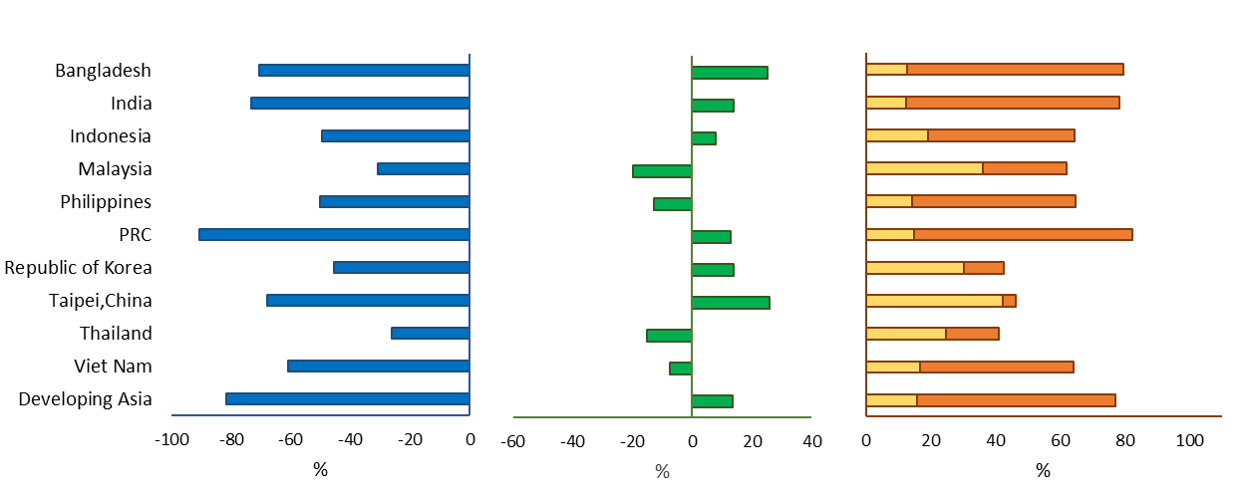
This countervailing force is at work across the region
Manufacturing
GVC = global value chain, PRC = People’s Republic of China.
Note: Developing Asia in the decomposition analysis includes Bangladesh, India, Indonesia, Malaysia, Mongolia, the People’s Republic of China, the Philippines, the Republic of Korea, Sri Lanka, Taipei,China, Thailand, and Viet Nam.
Source: ADB estimates using the ADB Multiregional Input–Output Database (accessed 20 November 2017); Labor force surveys, various countries; World Input–Output Database—Socioeconomic Accounts (Timmer et al. 2015).

Slide 23
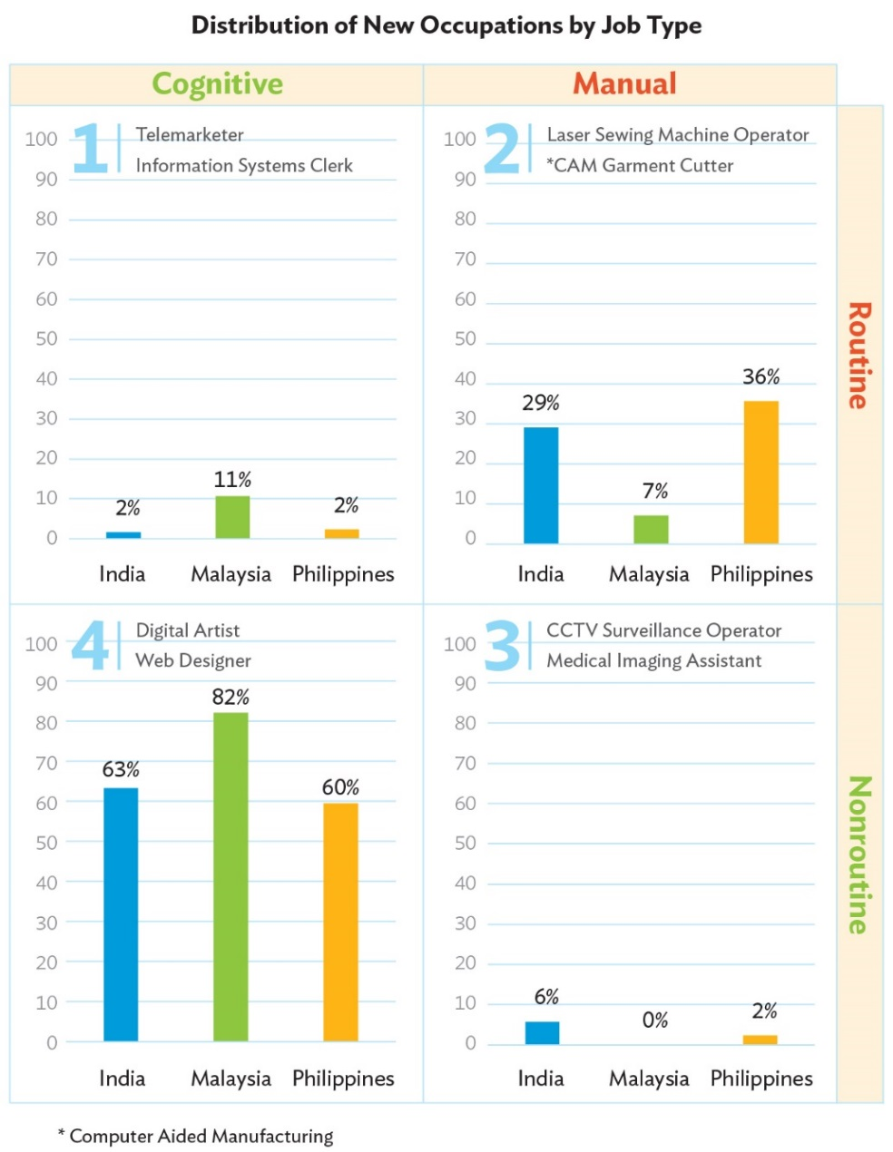
Technology leads to new occupations… but these tend to be in non-routine cognitive category
New job titles, various time periods
 | Total No. of Job Titles (latest year) | No. of New Job Titles | Share of New Job Titles
India 2004-2015 | 3,600 | 120 | 3.33%
Malaysia 1998-2008 | 2,338 | 28 | 1.20%
Philippines 1990-2012 | 3,698 | 42 | 1.14%
% refers to share of new job titles
Notes: The figures are based on a comparison of National Classification of Occupations (NCO) for each country.
Source: Asian Development Outlook 2018: How Technology Affects Jobs

Slide 24
Wages grew more for non-routine cognitive workers, leaving low-skill workers behind
Changes in average monthly wages, constant US dollar, various time periods*
Note: *The time frames vary across countries, with Viet Nam the shortest (2007‒2015), followed by Thailand (2000‒2010), India (2000‒2012), and Indonesia (2000‒2014). Developing Asia refers to the five countries included in this analysis. Source: Asian Development Outlook 2018: How Technology Affects Jobs

Slide 25
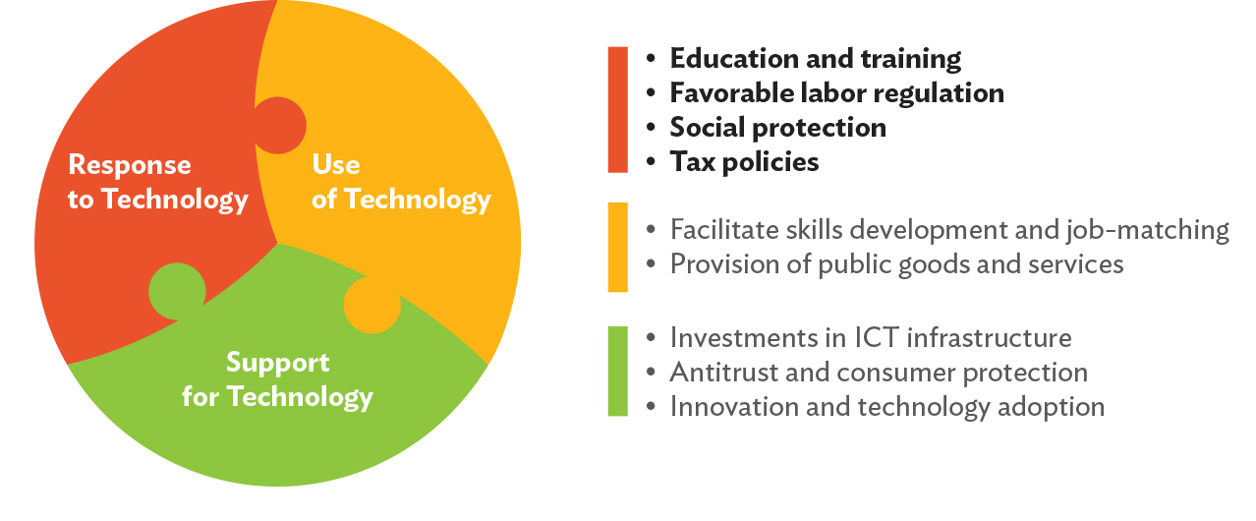
Government has an important role to play in leveraging technological advances for inclusive growth
The new industrial revolution and the role of government

Slide 26
Key messages
Developing Asia to continue solid growth at 6.0% in 2018 and 5.9% in 2019 amidst the strong external and domestic demand
PRC moderating with greater focus on financial stability; India rebounding from temporary reform related setbacks
Firming commodity prices and consumer demand push inflation to 2.9% in 2018 and 2019—still below 10-year average
Key risks stem from escalating trade tensions, rising US interest rates, and accumulating domestic private debt
New technologies are not likely to cause widespread job losses in Asia. But policy action is needed for workers to overcome challenges posed by technological advance, and harness its full benefits

